Slide 1

DELIVERY PROCESS ANALYSIS MÜSLI PROJECT
DATA ANALYTICS DEPARTMENT
April 2024

Slide 2
AGENDA
1
ORDER PROCESS FLOW CHART
2
KPIs
3
OUR PROCESS
4
OUR FINDINGS
5
CONCLUSIONS

Slide 3
AGENDA
1
ORDER PROCESS FLOW CHART
2
KPIs
3
OUR PROCESS
4
OUR FINDINGS
5
CONCLUSIONS

Slide 4
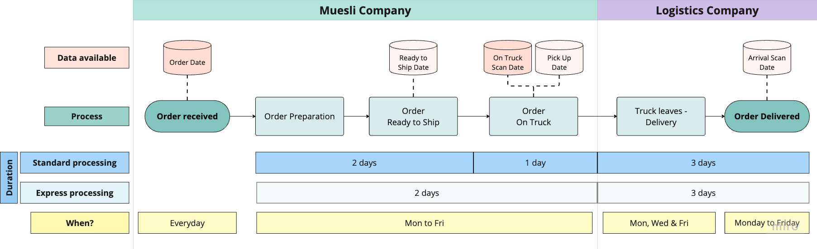
ORDER PROCESS FLOW CHART
1
Notes:
Describe the company
Explain the flowchart that reflects the process and add the flowchart explanation (with the data that we’ve been given that the “full color boxes” are full data and thr transparent ones are not reliable partial data but we took it as “accurate”)
assumptions on the data given
showcase the procedure and present the data that we’ve been given

Slide 5
AGENDA
1
ORDER PROCESS FLOW CHART
2
KPIs
3
OUR PROCESS
4
OUR FINDINGS
5
CONCLUSIONS

Slide 6
KPIs
2
Notes:
Order Fulfillment Time:
Objective: Validate that duration of preparation process in the warehouse takes 2 days
Measurement: order date & ready to ship date → Measures the time from the reception of the order until it is ready to be shipped

Slide 7
KPIs
2
KPI 1 : Order Fulfillment Time
Measures time from “Order received” to “Order Ready to Ship” in days
Calculation:
“Ready to Ship Date” - “Order Date”
Validate:
Order preparation time takes 2 days
Notes:
Order Fulfillment Time:
Objective: Validate that duration of preparation process in the warehouse takes 2 days
Measurement: order date & ready to ship date → Measures the time from the reception of the order until it is ready to be shipped

Slide 8
KPIs
2
KPI 2 : Order Loading Time
Measures time from “Order Ready to Ship” to “On Truck Scan Date” in days
Calculation:
“On Truck Scan Date” - “Ready to Ship Date”
Validate:
Order loading time takes 1 day for Standard Processing and same day for Express Processing
Notes:
Order Fulfillment Time:
Objective: Validate that duration of preparation process in the warehouse takes 2 days
Measurement: order date & ready to ship date → Measures the time from the reception of the order until it is ready to be shipped

Slide 9
KPIs
2
KPI 3 : Order Delivery Time
Measures time from “Order on Truck” to “Order Delivered” in days
Calculation:
“Arrival Scan Date” - “On Truck Scan Date”
Validate:
Order delivery time takes 3 days as Logistics Company calculated
Notes:
Order Fulfillment Time:
Objective: Validate that duration of preparation process in the warehouse takes 2 days
Measurement: order date & ready to ship date → Measures the time from the reception of the order until it is ready to be shipped

Slide 10
KPIs
2
KPI 4 : Order Processing Time
Measures time from “Order Date” to “ Arrival Scan Date” in days
Calculation:
“Arrival Scan Date” - “Order Date”
Validate:
Order processing time takes 6 days for standard processing and 5 days for express processing
Notes:
Order Fulfillment Time:
Objective: Validate that duration of preparation process in the warehouse takes 2 days
Measurement: order date & ready to ship date → Measures the time from the reception of the order until it is ready to be shipped

Slide 11
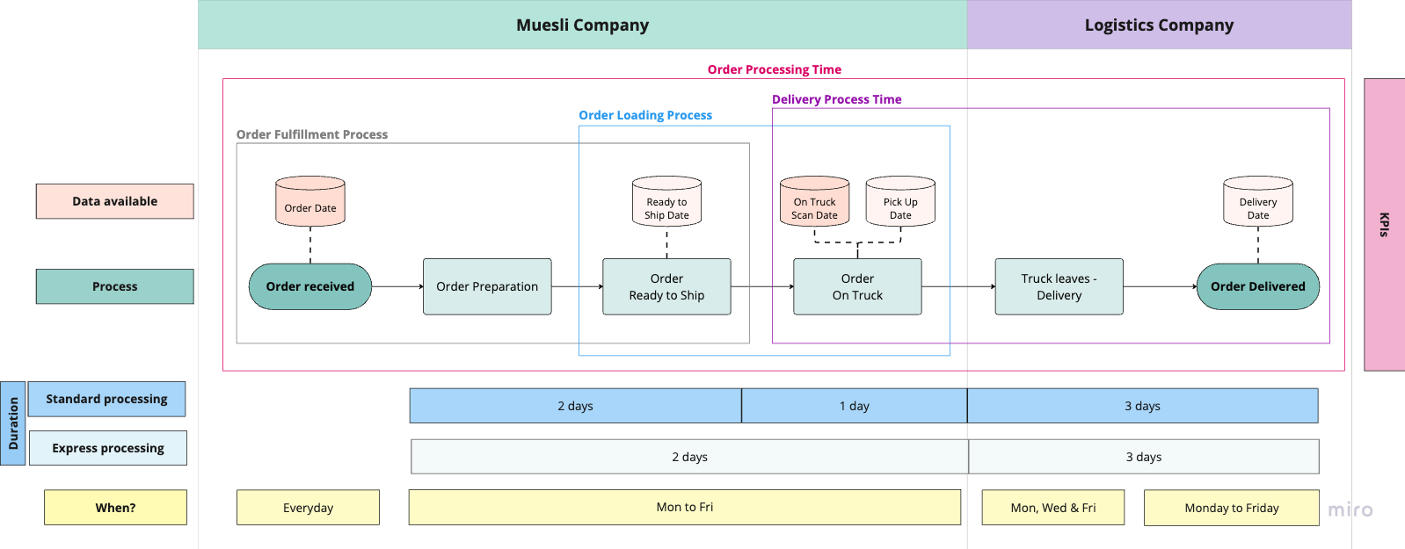
KPIs
2
Notes:
Order Processing Time:
Objective: Validate the time that the whole procedure takes, form order reception to arriva scan date
Measurement: Measures the time of the whole process

Slide 12
AGENDA
1
ORDER PROCESS FLOW CHART
2
KPIs
3
OUR PROCESS
4
OUR FINDINGS
5
CONCLUSIONS

Slide 13
OUR PROCESS
3
Data examination
Data cleaning
Merging data
Notes:
data examination, cleaning and visualization of the results

Slide 14
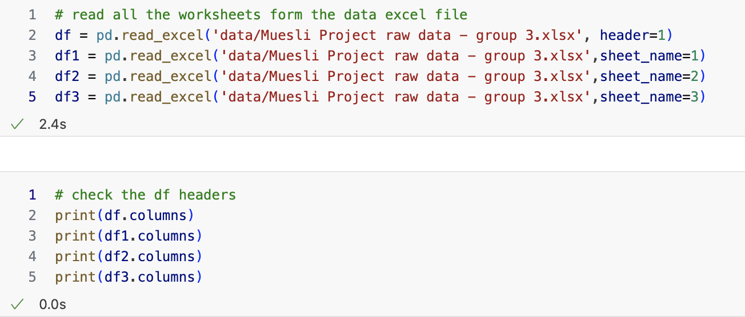
OUR PROCESS
3
Data examination
Notes:
We discuss here the data that has been given to us
The raw data provided was given in different worksheets which proves the data is not very consistent and reliable

Slide 15
OUR PROCESS
3
Data examination
Orders
Index
Order ID
Order Date
Ship Mode
Customer ID
Customer Name
Origin Channel
Country/Region
City
State
Postal Code
Region
Category
Sub-Category
Product ID
Sales
Quantity
Discount
Profit
Campaign Data Order ID
Arrival Scan Date
Customer Name
Order Process Data Row ID
Order ID
Order Date
On Truck Scan Date
Ship Mode
Internal Data Study Order ID
Ready to Ship Date
Pickup Date
Notes:
We discuss here the data that has been given to us
The raw data provided was given in different worksheets which proves the data is not very consistent and reliable

Slide 16
OUR PROCESS
3
Data examination
Orders
Index
Order ID
Order Date
Ship Mode
Customer ID
Customer Name
Origin Channel
Country/Region
City
State
Postal Code
Region
Category
Sub-Category
Product ID
Sales
Quantity
Discount
Profit
Campaign Data Order ID
Arrival Scan Date
Customer Name
Order Process Data Row ID
Order ID
Order Date
On Truck Scan Date
Ship Mode
Internal Data Study Order ID
Ready to Ship Date
Pickup Date
Standard Processing
Express
First Class
Second Class
Standard Class
Notes:
We discuss here the data that has been given to us
The raw data provided was given in different worksheets which proves the data is not very consistent and reliable

Slide 17
OUR PROCESS
3
Data examination
Orders
Index
Order ID
Order Date
Ship Mode
Customer ID
Customer Name
Origin Channel
Country/Region
City
State
Postal Code
Region
Category
Sub-Category
Product ID
Sales
Quantity
Discount
Profit
Campaign Data Order ID
Arrival Scan Date
Customer Name
Order Process Data Row ID
Order ID
Order Date
On Truck Scan Date
Ship Mode
Internal Data Study Order ID
Ready to Ship Date
Pickup Date
Notes:
We discuss here the data that has been given to us
The raw data provided was given in different worksheets which proves the data is not very consistent and reliable

Slide 18
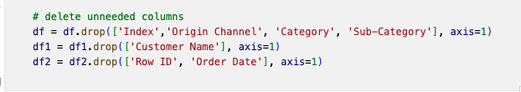
OUR PROCESS
3
Data cleaning
Notes:
Begin first cleaning process and showcase the first columns we deleted

Slide 19
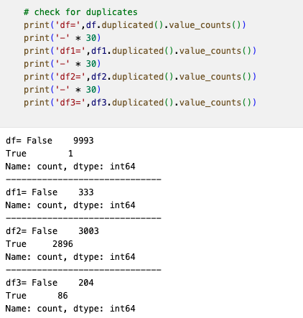
OUR PROCESS
3
Data cleaning
Notes:
Begin first cleaning process and showcase the first columns we deleted

Slide 20
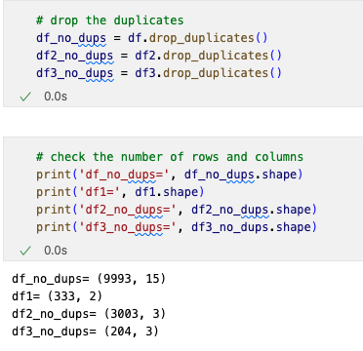
OUR PROCESS
3
Data cleaning
Notes:
Begin first cleaning process and showcase the first columns we deleted

Slide 21
OUR PROCESS
3
Data cleaning
Notes:
Begin first cleaning process and showcase the first columns we deleted

Slide 22
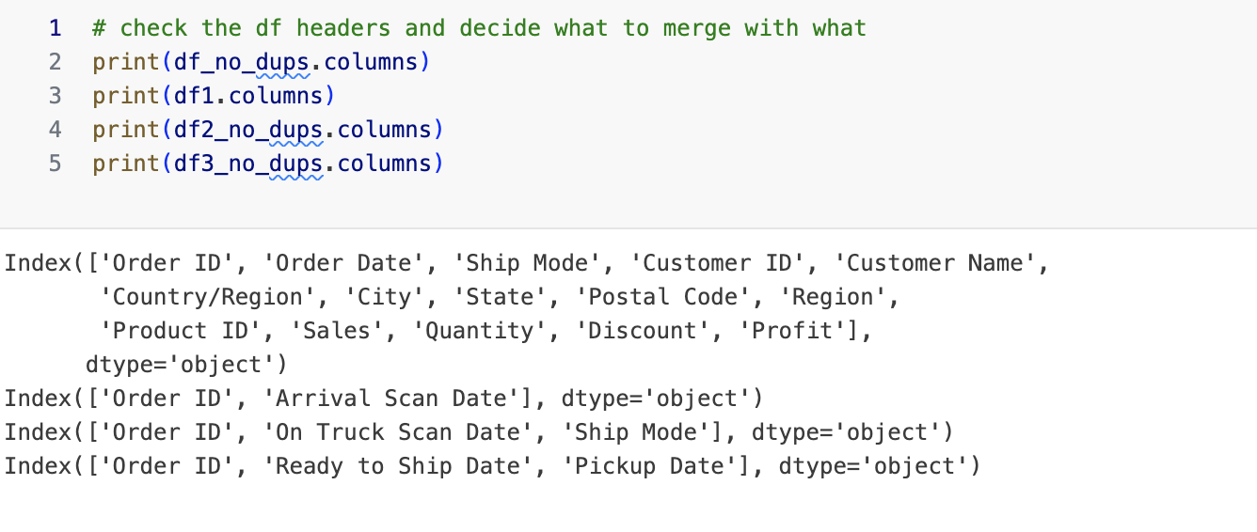
OUR PROCESS
3
Data merging
Notes:
Begin first cleaning process and showcase the first columns we deleted

Slide 23
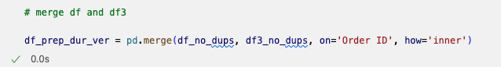
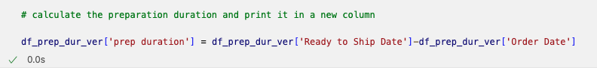
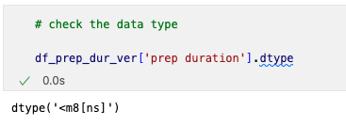
Data cleaning
1ST KPI - ORDER FULFILLMENT PROCESS
Order Fulfillment Process - add the dates we want to compare
Notes:
Order Fulfillment Process
Compared the data “Order Date” & “Ready to Ship Date”

Slide 24
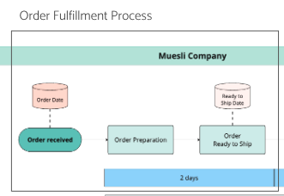
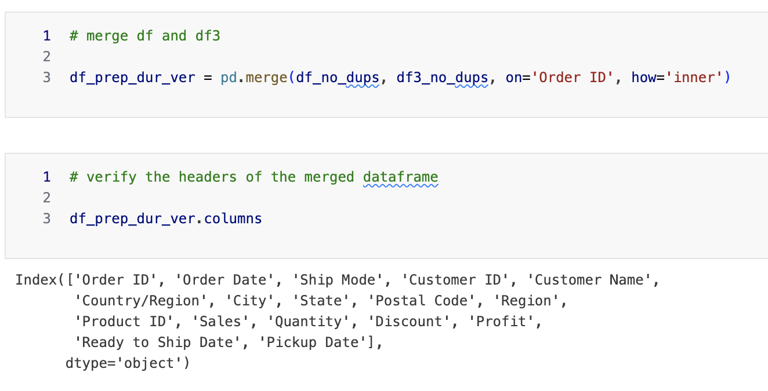
OUR PROCESS
KPI 1 - Order Fulfillment Time
3
Notes:
Order Fulfillment Process
Compared the data “Order Date” & “Ready to Ship Date”

Slide 25
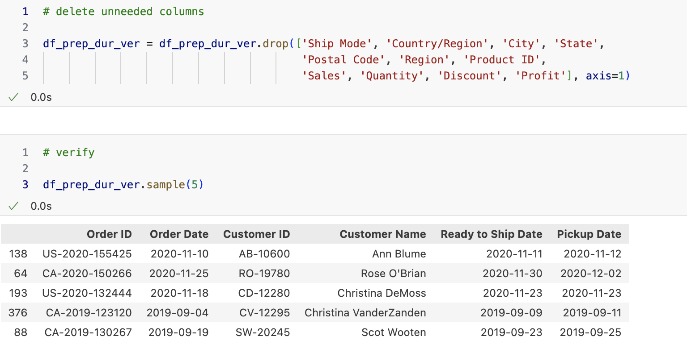
KPI 1 - Order Fulfillment Time
Notes:
Order Fulfillment Process
Compared the data “Order Date” & “Ready to Ship Date”

Slide 26
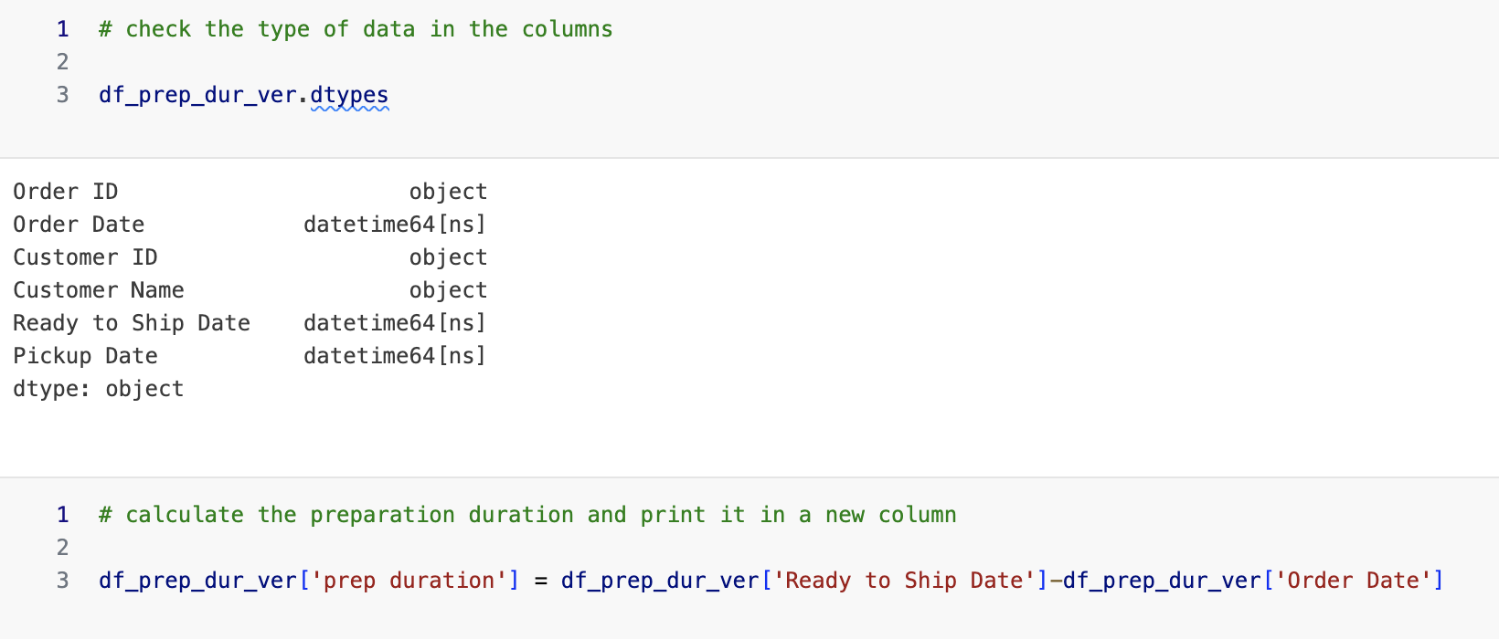
KPI 1 - Order Fulfillment Time
Notes:
Order Fulfillment Process
Compared the data “Order Date” & “Ready to Ship Date”

Slide 27
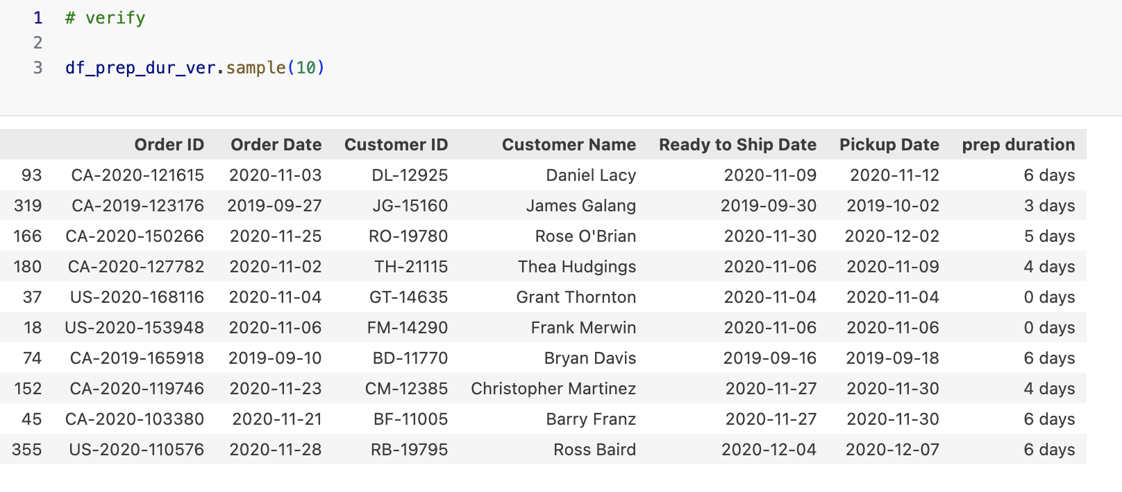
KPI 1 - Order Fulfillment Time
Notes:
Order Fulfillment Process
Compared the data “Order Date” & “Ready to Ship Date”

Slide 28
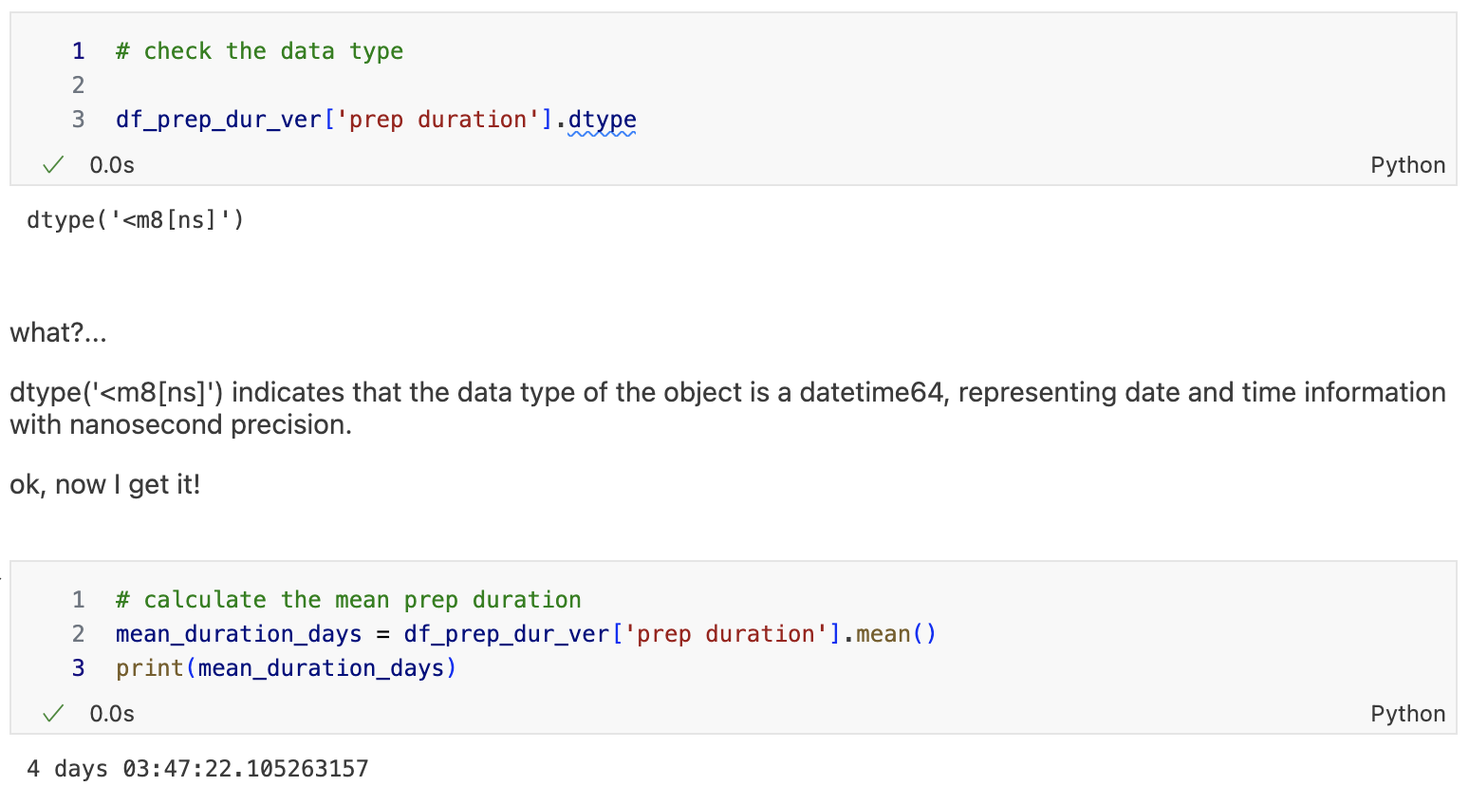
KPI 1 - Order Fulfillment Time
Notes:
Order Fulfillment Process
Compared the data “Order Date” & “Ready to Ship Date”

Slide 29
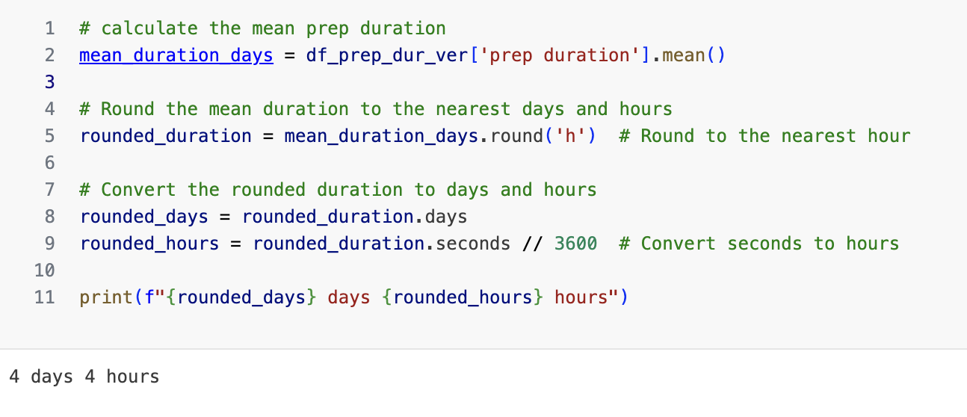
KPI 1 - Order Fulfillment Time
Notes:
Order Fulfillment Process
Compared the data “Order Date” & “Ready to Ship Date”

Slide 30

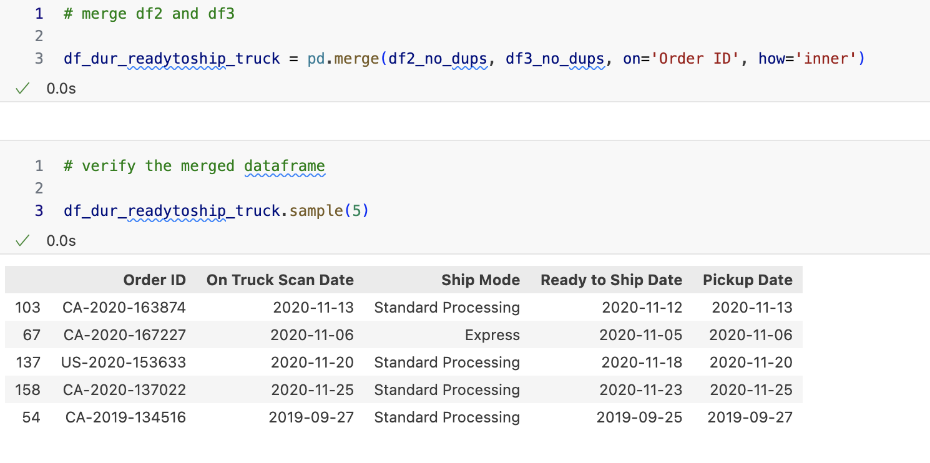
KPI 2 - Order Loading Time
Notes:
add dates

Slide 31
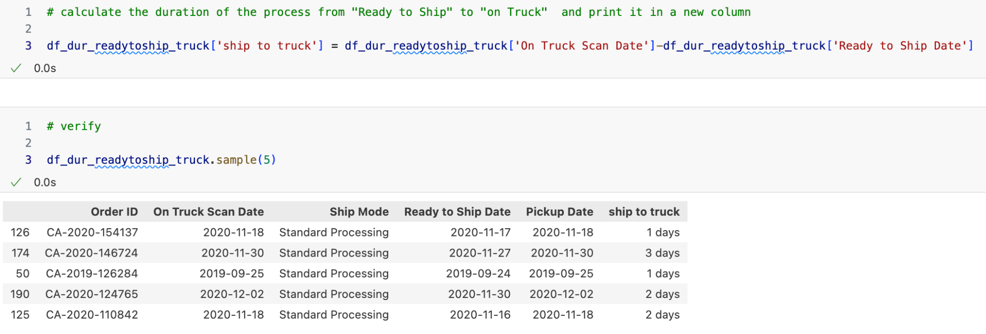
KPI 2 - Order Loading Time
Notes:
add dates

Slide 32
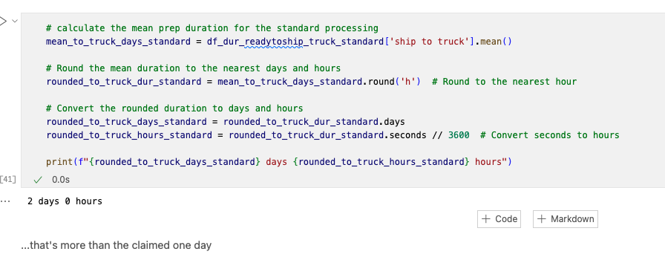
KPI 2
Order Loading Time
Notes:
add dates

Slide 33
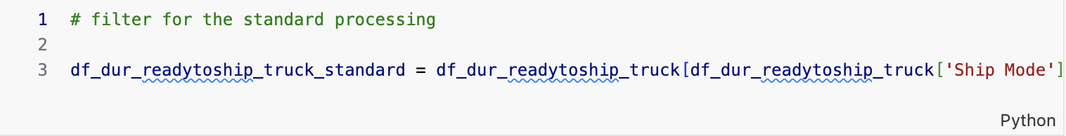
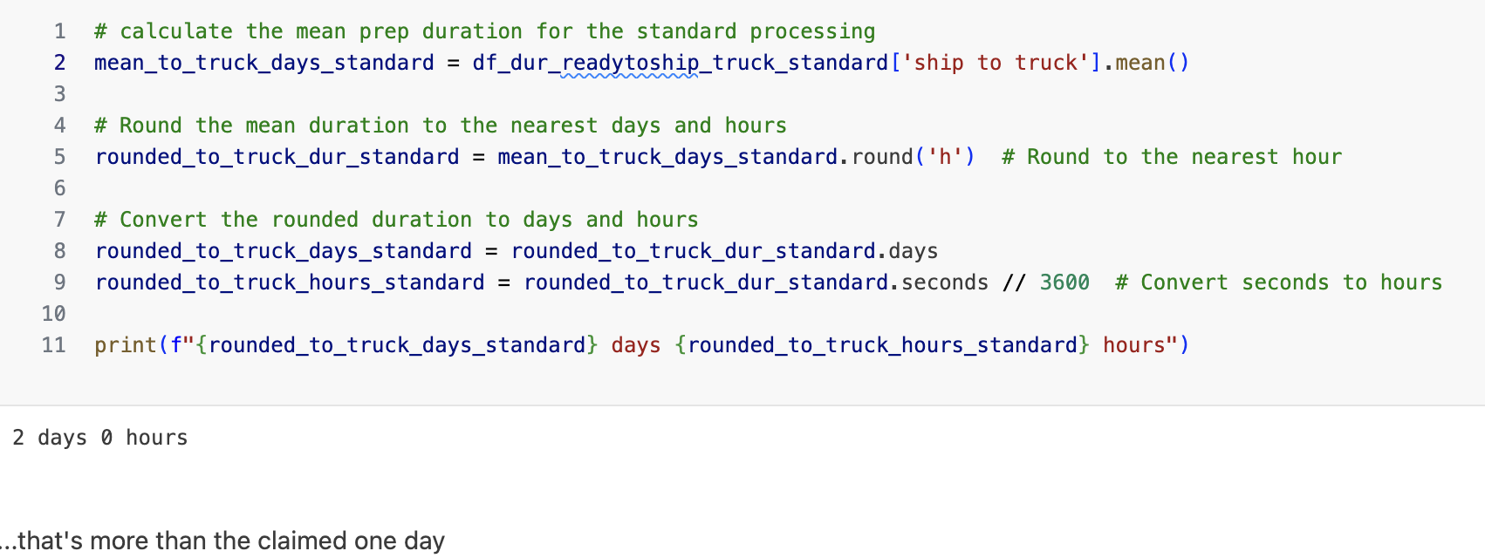
KPI 2 - Order Loading Time
Standard Processing
Notes:
add dates

Slide 34
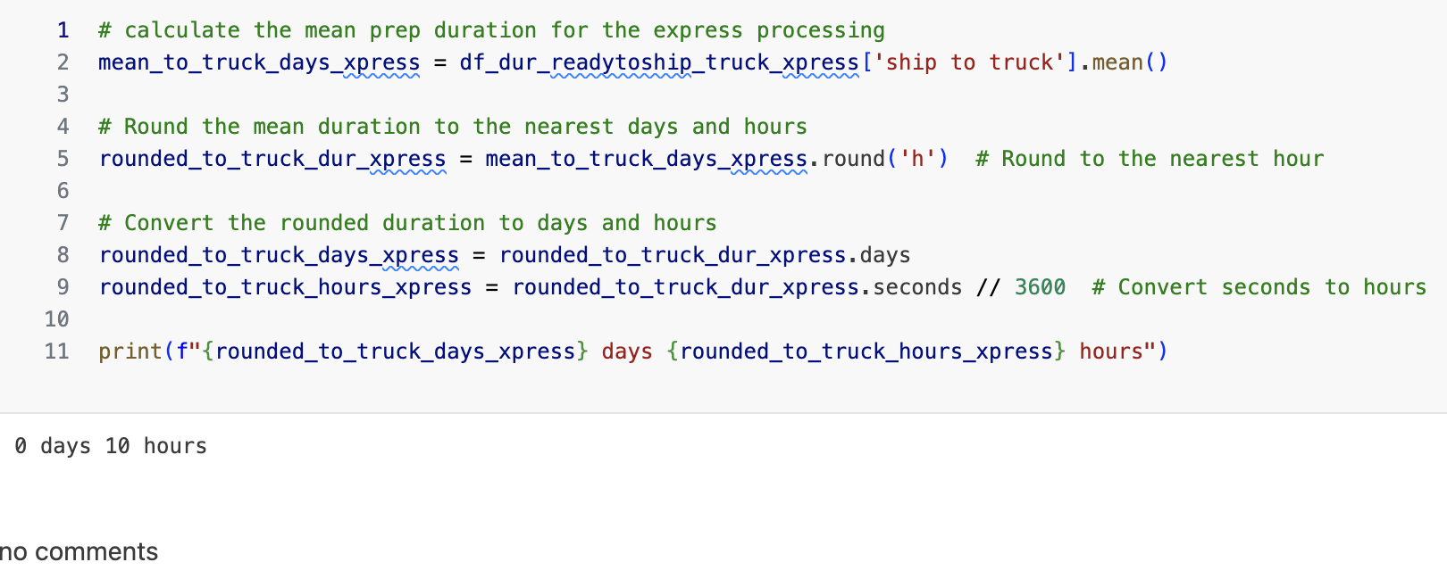
KPI 2 - Order Loading Time
Express Processing
Notes:
double checked it with pick up date too and got slightly different results

Slide 35
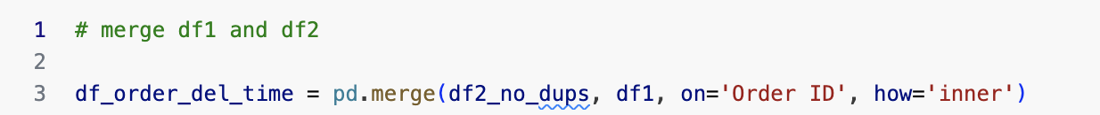
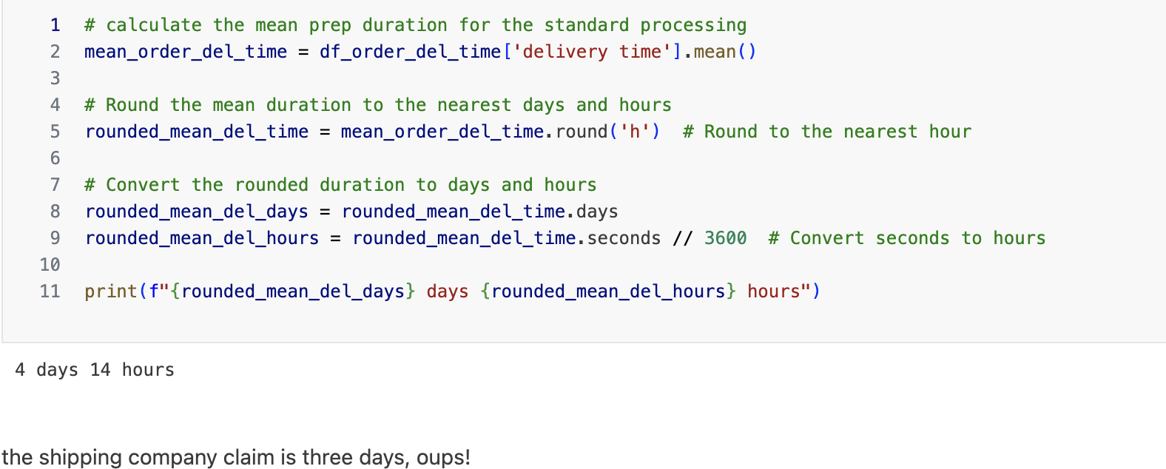
KPI 3 - Order Delivery Time
Notes:
double checked it with pick up date too and got slightly different results

Slide 36
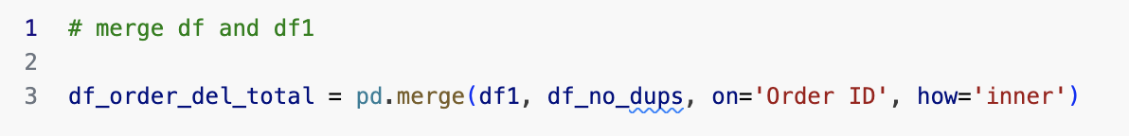
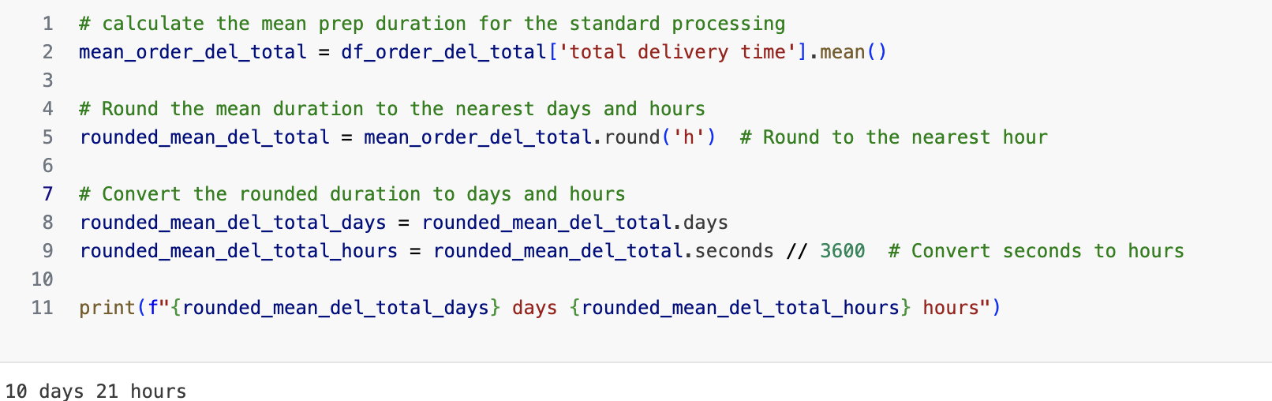
KPI 4 - Order Processing Time
Notes:
double checked it with pick up date too and got slightly different results

Slide 37
AGENDA
1
ORDER PROCESS FLOW CHART
2
KPIs
3
OUR PROCESS
4
OUR FINDINGS
5
CONCLUSIONS

Slide 38
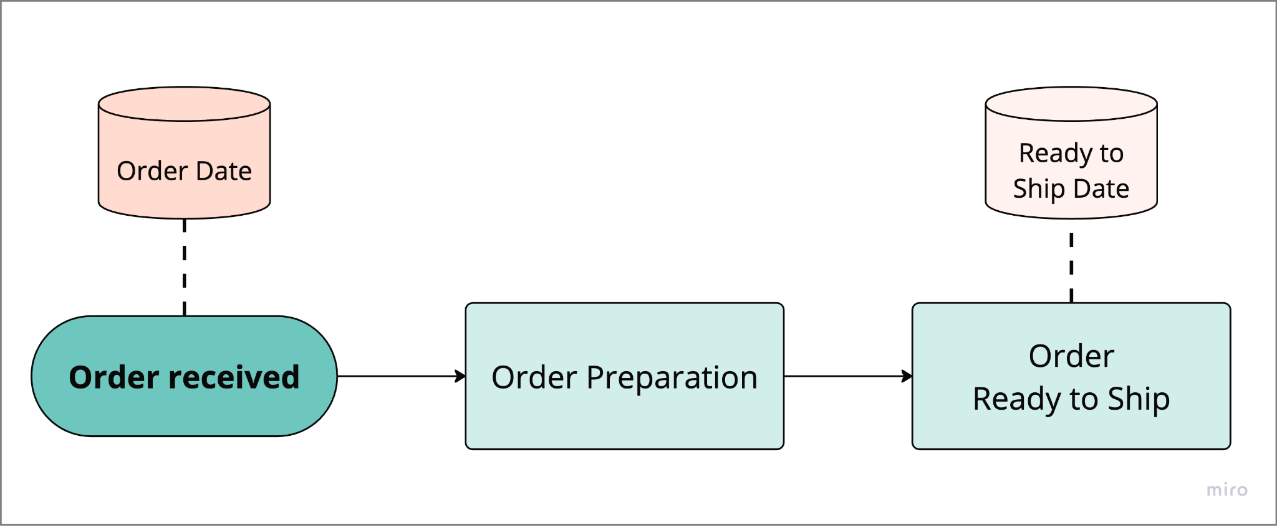
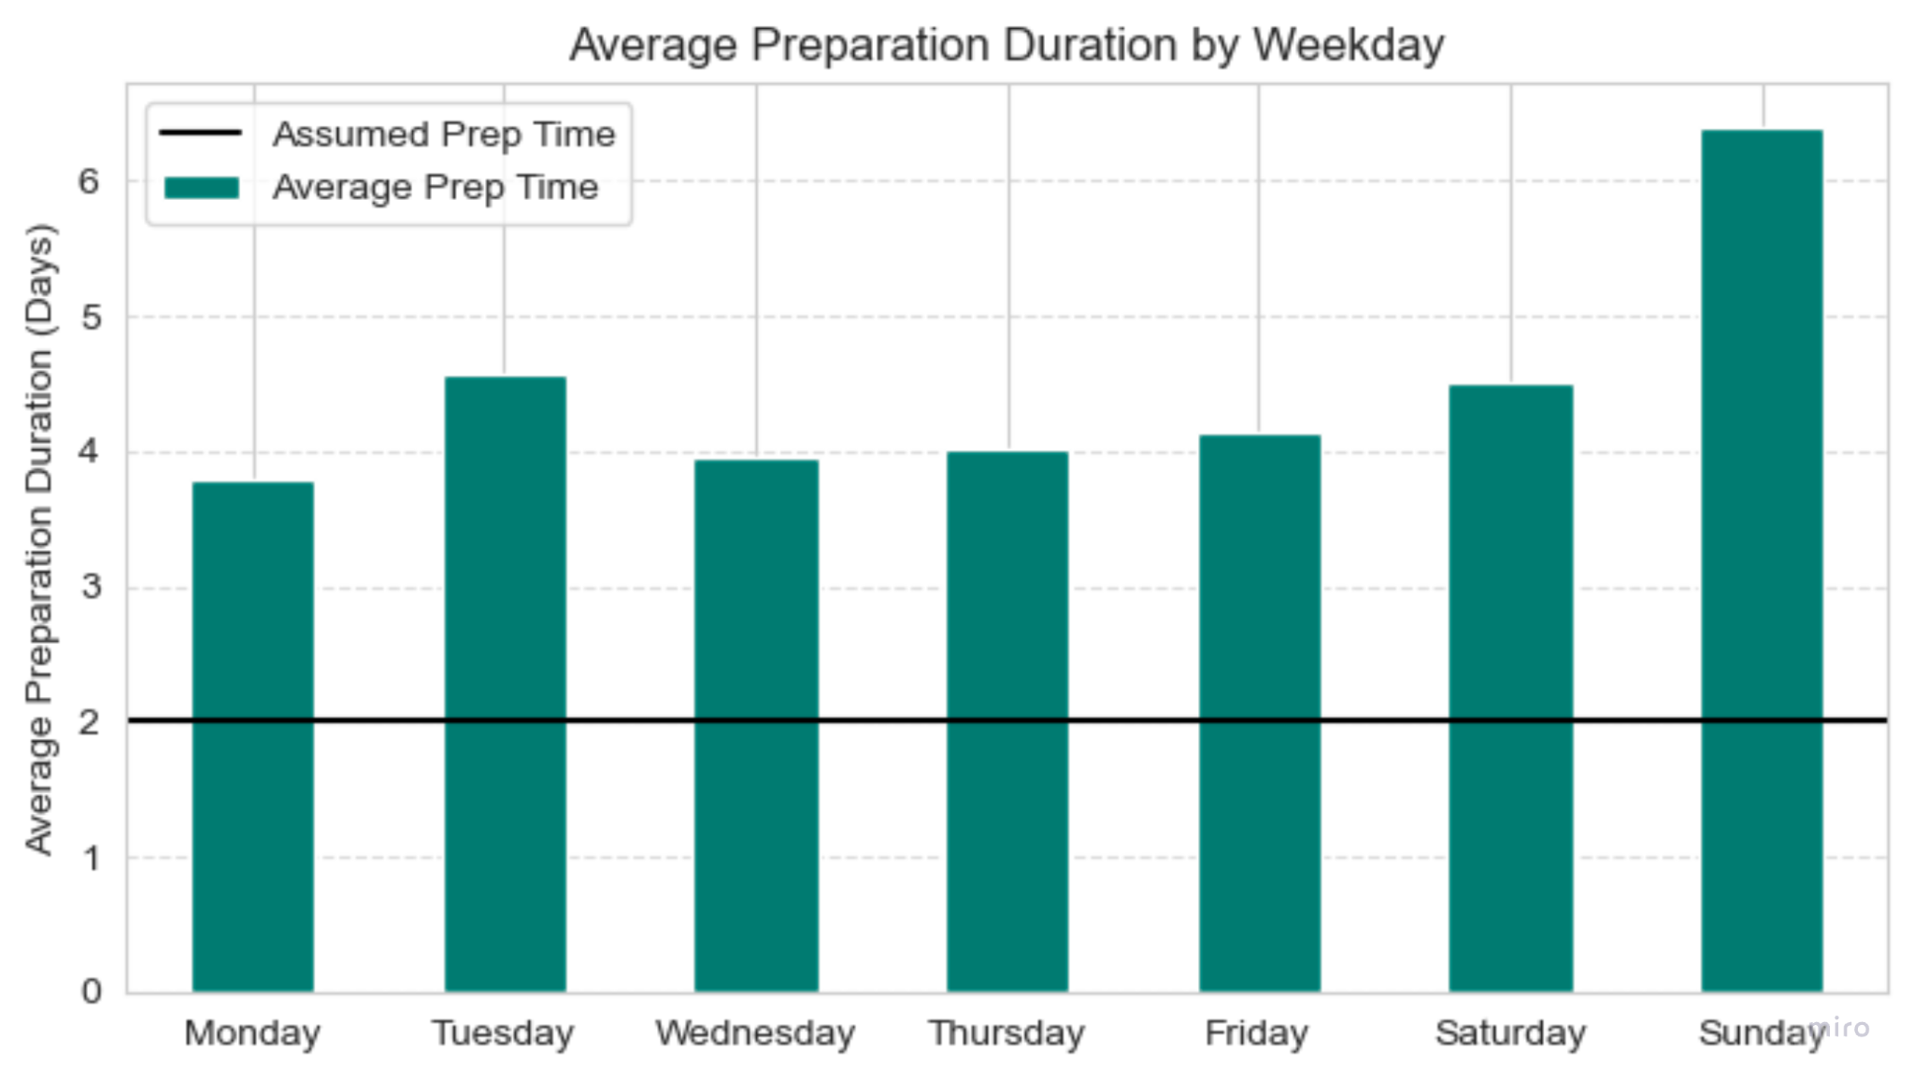
KPI 1 - Order Fulfillment Time
Average Preparation Time 4,5 Days

Slide 39
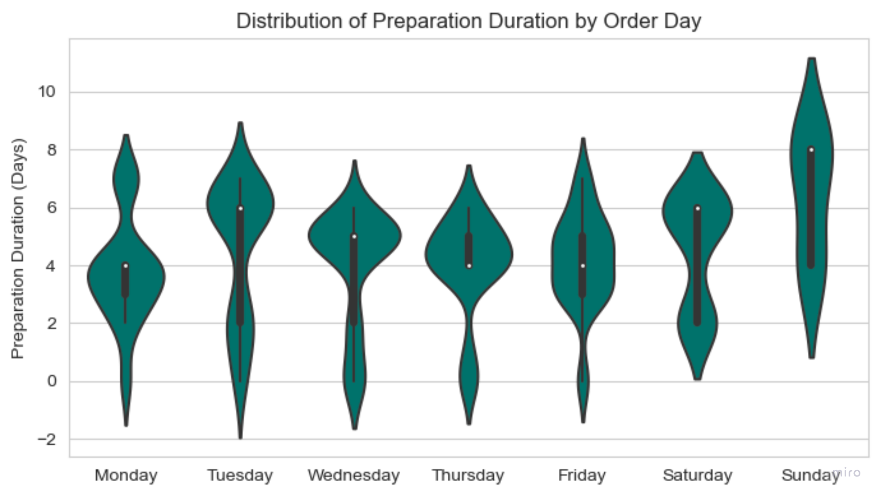
KPI 1 - Order Fulfillment Time
Preparation Time:
69% late
20% on time
11% early

Slide 40
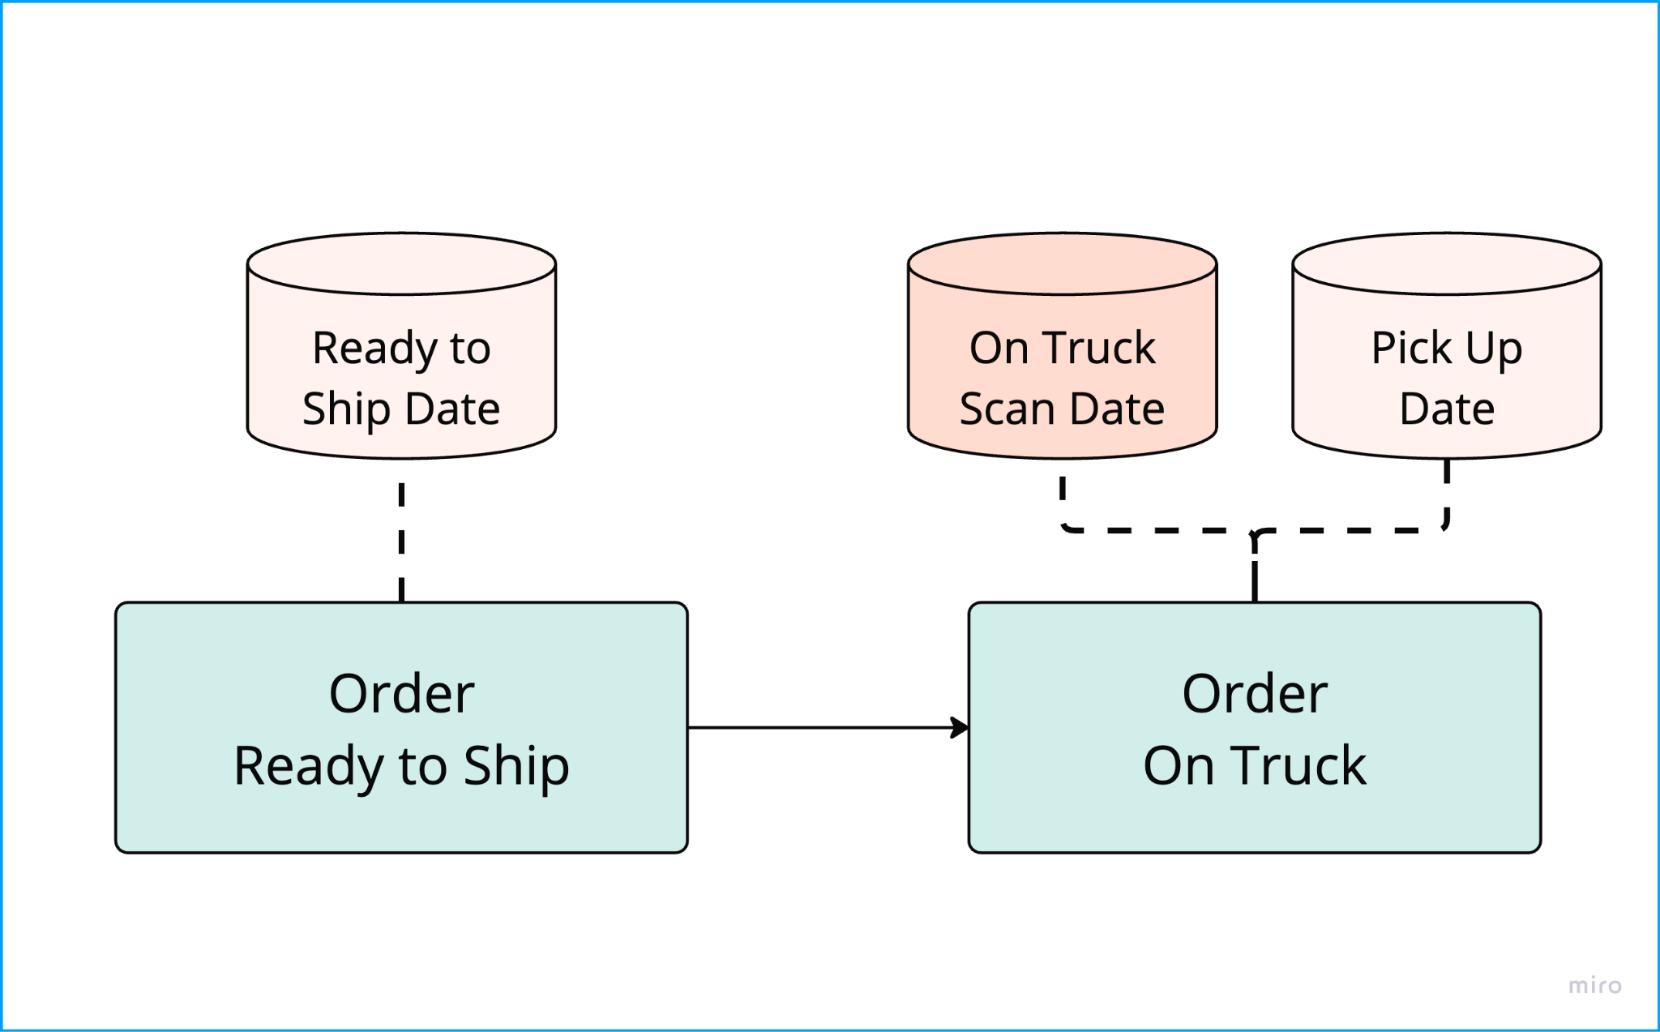
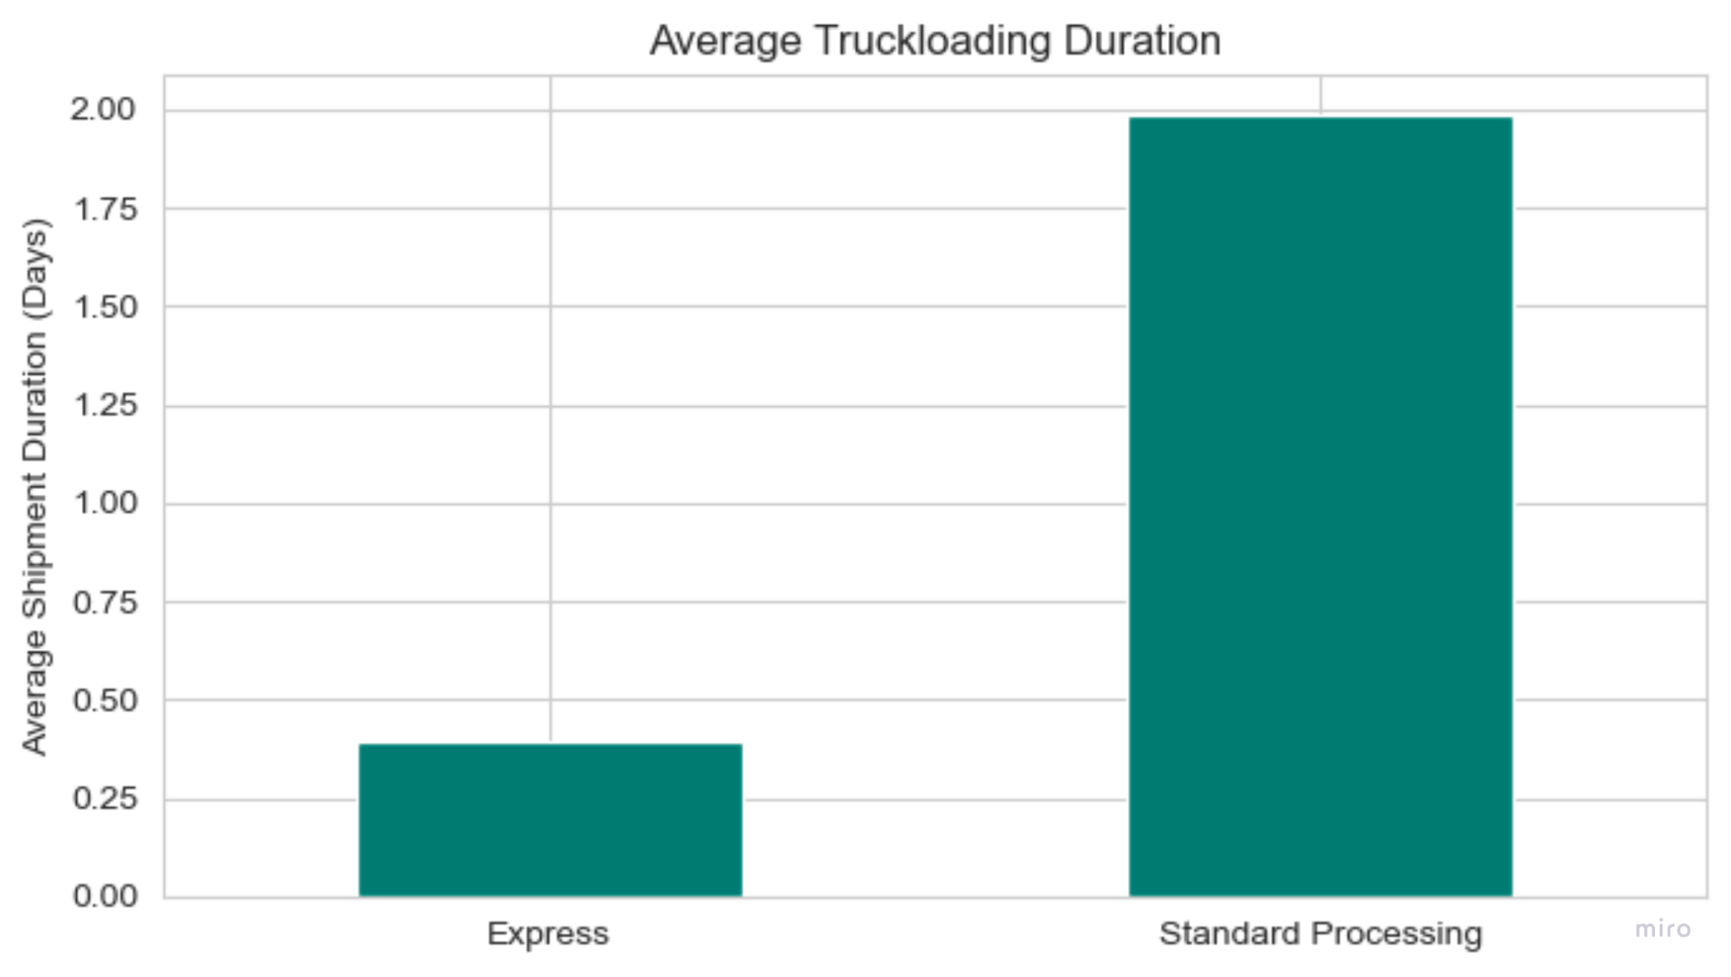
KPI 2 - Order Loading Time

Slide 41
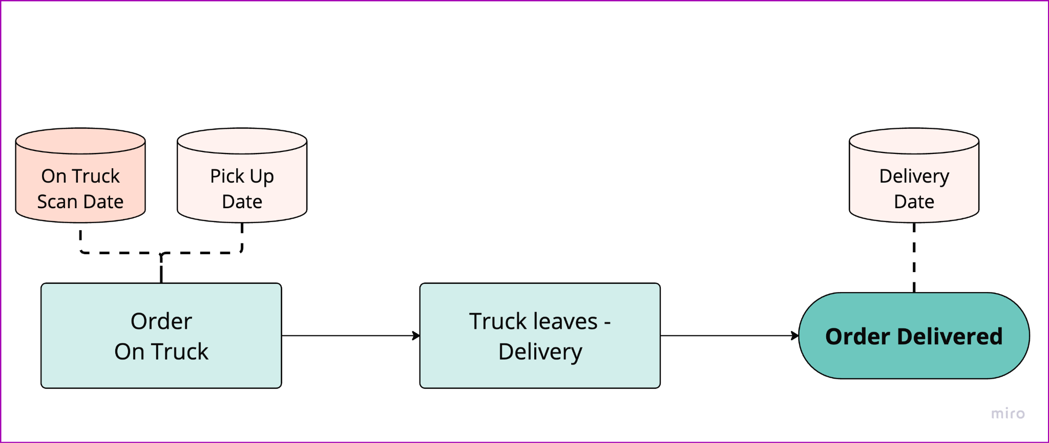
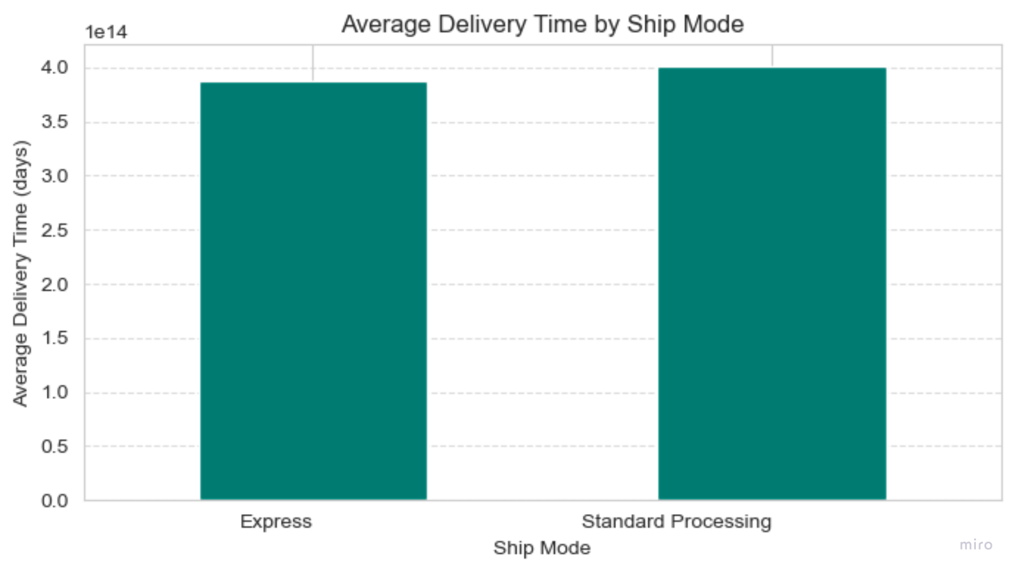
KPI 3 - Order Delivery Time

Slide 42
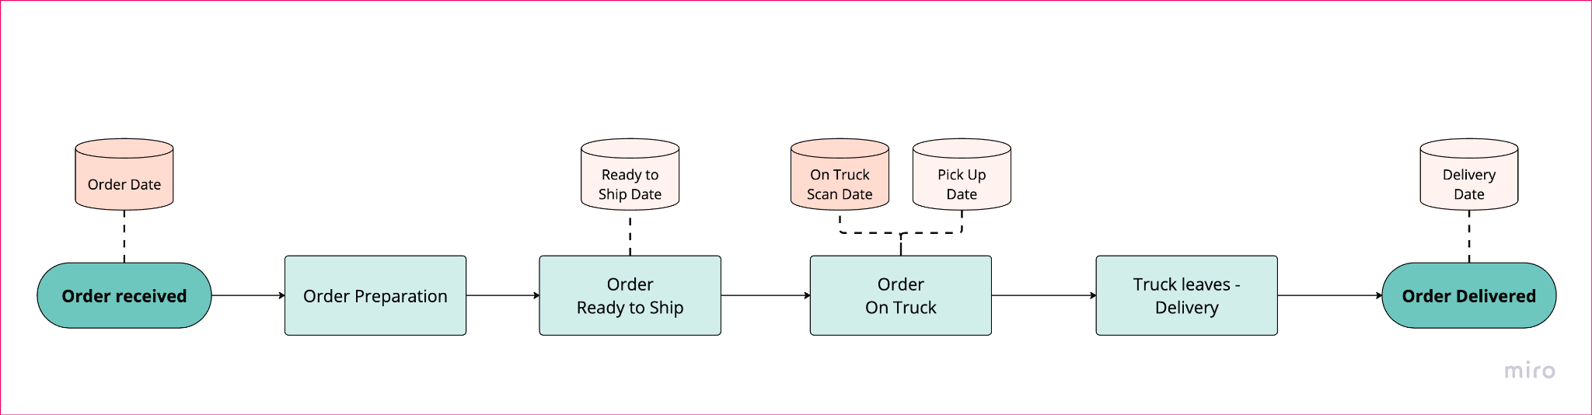
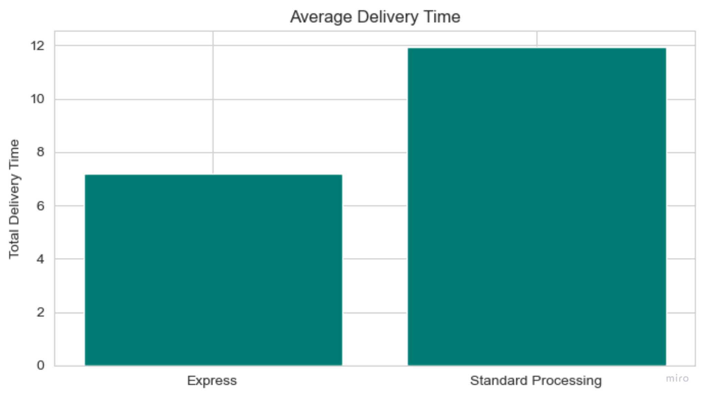
KPI 4 - Order Processing Time

Slide 43
AGENDA
1
ORDER PROCESS FLOW CHART
2
KPIs
3
OUR PROCESS
4
OUR FINDINGS
5
CONCLUSIONS

Slide 44
CONCLUSIONS
5
preparation of orders in warehouse much longer than 2 days
only 20% of orders are prepared in 2 days, 69% are late
↘ decrease preparation time in warehouse
express in order loading process takes desired time
↘ decrease loading time for standard to express time
difference in delivery time: average 4 days instead of 3 days
↺ no accurate data - get real data from delivery company
Notes:
finally I want to wrap up our findings
as you saw earlier: preparation of order in warehouse takes much longer than the 2 days you assumed
only 20% of the orders are prepared in the assumed 2 days, while 69% are late
so we suggest to decrease the preparation time in the warehouse to the 2 days you assumed
the next task is, that you told us standard orders would be loaded the day after they are ready to ship - and express ones leave the warehouse the same day
we found out for express it’s as you assumed, so we suggest you decrease the loading time for standard orders to the time you need for express orders
and we also found out that the average time, the delivery company takes to deliver the packages, is 4 days and not the assumed 3 days
as we don’t have accurate data in the delivery process, we need to get real data from there to see if something can be changed

Slide 45
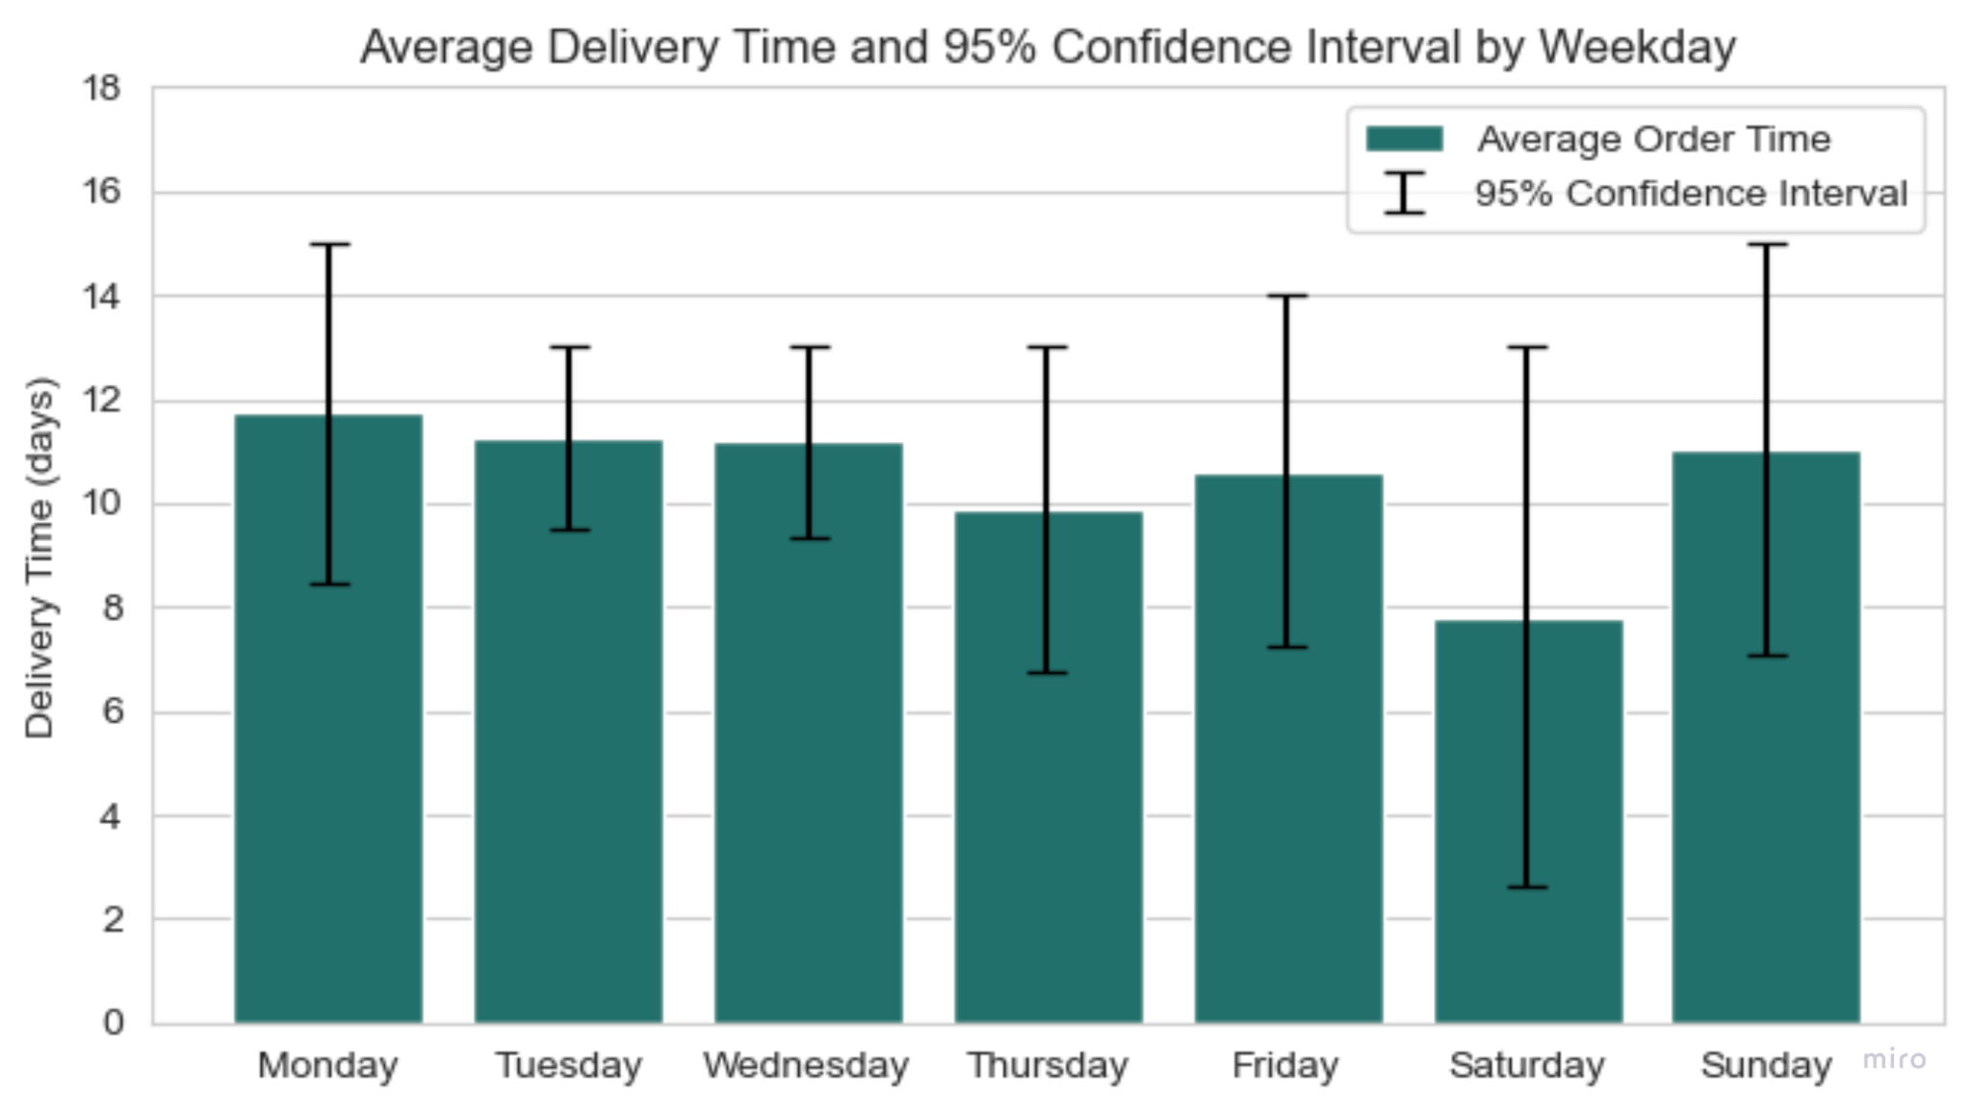
CONCLUSIONS
5
overall process:
↭ no consistency for preparation time for orders
↘ same time period for every weekday
Notes:
in the overall process we found out you have a large time period for the orders to be prepared and delivered to the customer
in the graph the black lines show the 95 % of all packages to be delivered in this amount of days
it takes for example from 8 to 15 days n mondays and especially when customers order on saturdays 95 % of the packages are delivered within three or even eleven days - that’s quite a large time period
there is no consistency in delivery time
so one goal could be to have the same preparation and delivery time for every weekday

Slide 46
CONCLUSIONS
4
5
overall process:
↭ no consistency for preparation time for orders
↘ same time period for every weekday
in summary express delivery is faster than standard, though no difference in loading time (as assumed)
→ apparently faster in warehouse
Notes:
we also found out that in summary the express delivery is faster than the standard one - although there was no difference in the loading time as you assumed
apparently express deliveries go faster through the warehouse but we aren’t sure as we have no data there

Slide 47
OVERALL CONCLUSIONS
5
check efficiency of workflow (warehouse and loading)
increase the amount of measurements in warehouse process
Notes:
as we could see before, the processes in the different parts (warehouse, loading) take way longer than you assumed
you can decrease your preparation time by
take a look at the efficiency of your workflow in the warehouse (order preparation) and the loading
NEXT SLIDE
increase the amount of measurements in the warehouse process as it seems to be most time consuming
so we might find out the real time the orders take to be prepared in the warehouse, loaded and delivered
arrows: new datapoints could be
at the beginning of the preparation process to get some information about the time between ordering and starting preparing
at the end of the preparation process to know the real duration of the preparation process
we also need confident data about the “ready to ship” point to have exact informations when the orders leave the muesli company
and it would also be useful to get informations from the delivery company when the endusers finally receives their goods
so finally do you want to discuss about our conclusions or do you have any further tasks to talk about?

Slide 48
OVERALL CONCLUSIONS
5
check efficiency of workflow (warehouse and loading)
increase the amount of measurements in warehouse process
Notes:
as we could see before, the processes in the different parts (warehouse, loading) take way longer than you assumed
you can decrease your preparation time by
take a look at the efficiency of your workflow in the warehouse (order preparation) and the loading
NEXT SLIDE
increase the amount of measurements in the warehouse process as it seems to be most time consuming
so we might find out the real time the orders take to be prepared in the warehouse, loaded and delivered
arrows: new datapoints could be
at the beginning of the preparation process to get some information about the time between ordering and starting preparing
at the end of the preparation process to know the real duration of the preparation process
we also need confident data about the “ready to ship” point to have exact informations when the orders leave the muesli company
and it would also be useful to get informations from the delivery company when the endusers finally receives their goods

Slide 49
Overall Conclusions
4
check efficiency of workflow (warehouse and loading)
increase the amount of measurements in warehouse process
increase workforce
something with the delivery company
Notes:
as we could see before, the processes in the different parts (warehouse, loading) take way longer than you assumed
you can decrease your delivery time by
take a look at the efficiency of your workflow in the warehouse and the loading
increase the amount of measurements in the warehouse process as it seems to be most time consuming
to see if you might have to increase the workflow
and you could also look for another delivery company

Slide 51
TIME FOR QUESTIONS

